Slide 1
Recurrent Autoencoder Networks for Koopman Spectral Analysis
Samuel Otto
Bill Eggert

Slide 2
Introduction and Motivation
We want to explore data driven modeling of dynamical systems using machine learning
Dynamical systems (e.g., turbulent flow) are traditionally handled with Direct Numerical Simulation, or State Space Reduction
We propose another method: RNN’s with autoencoders

Slide 3
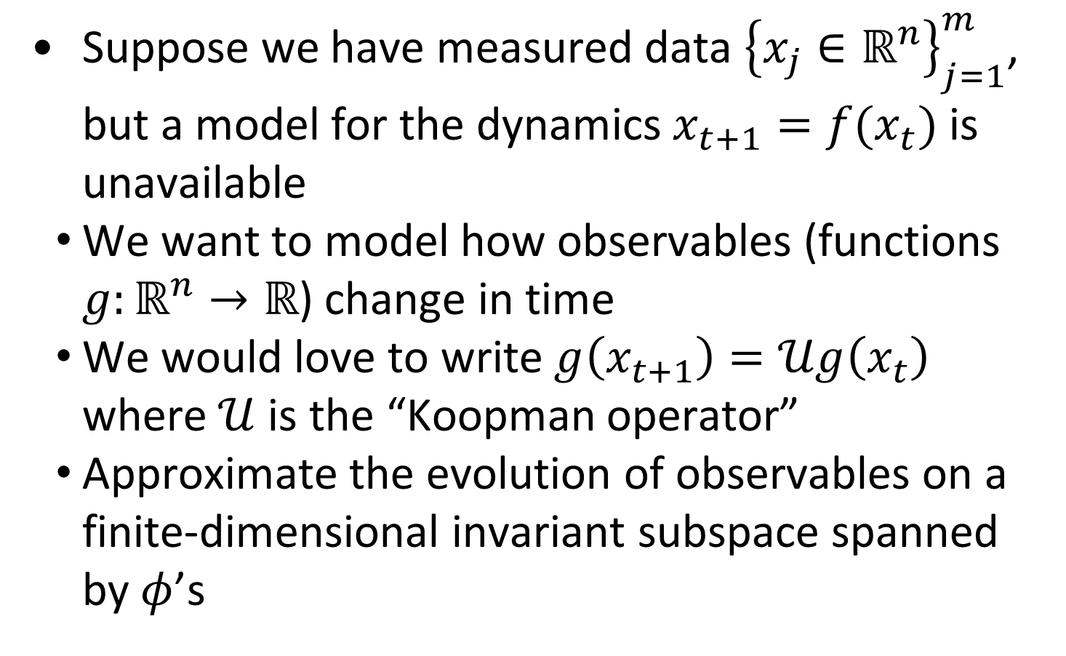
The Basics
Suppose we have measured data ${\left\{x_{j}∈ℝ^{n}\right\}}_{j=1}^{m}$, but a model for the dynamics $x_{t+1}=f(x_{t})$ is unavailable
We want to model how observables (functions $g:ℝ^{n}→ℝ$) change in time
We would love to write $g\left(x_{t+1}\right)=𝒰g\left(x_{t}\right)$ where $𝒰$ is the “Koopman operator”
Approximate the evolution of observables on a finite-dimensional invariant subspace spanned by $φ$’s

Slide 4

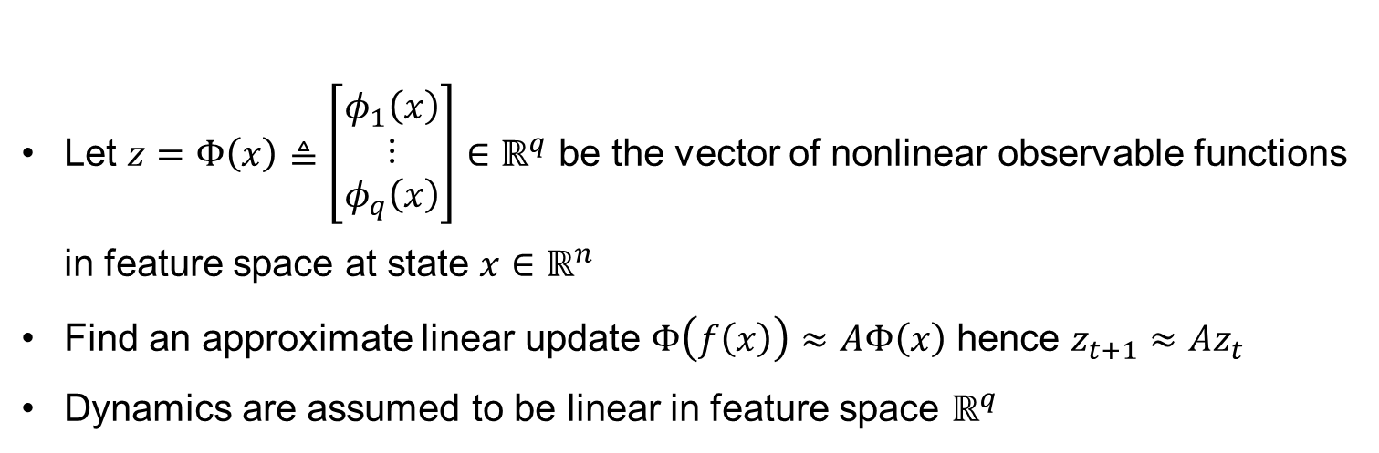




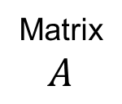

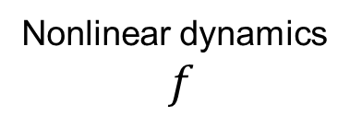




Linear Dynamics in Feature Space
Let $z=Φ\left(x\right)≜\left[\begin{aligned}φ_{1}\left(x\right) \\ ⋮ \\ φ_{q}\left(x\right)\end{aligned}\right]∈ℝ^{q}$ be the vector of nonlinear observable functions in feature space at state $x∈ℝ^{n}$
Find an approximate linear update $Φ\left(f\left(x\right)\right)≈AΦ\left(x\right)$ hence $z_{t+1}≈Az_{t}$
Dynamics are assumed to be linear in feature space $ℝ^{q}$
$$x_{t}$$
$$x_{t+1}$$
Nonlinear dynamics
$f$
$$ℝ^{n}$$
$$ℝ^{n}$$
$$Φ$$
$$Φ$$
Matrix
$$A$$
$$ℝ^{q}$$
$$ℝ^{q}$$
$$z_{t}$$
$$Az_{t}≈z_{t+1}$$

Slide 5

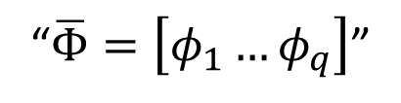










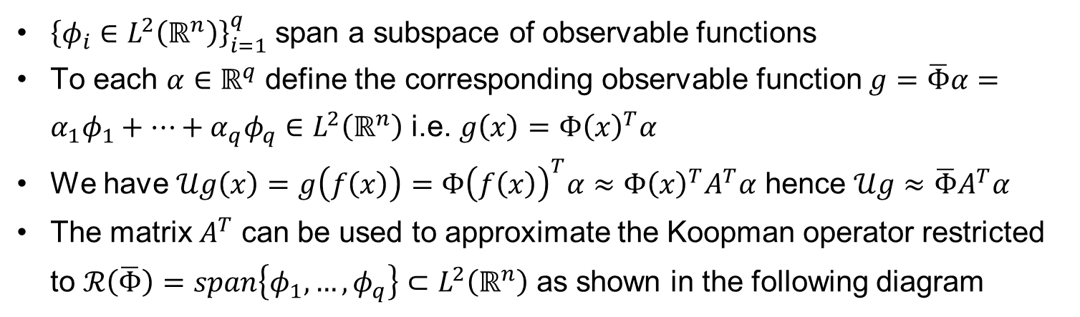
Approximating Koopman
${\left\{φ_{i}∈L^{2}\left(ℝ^{n}\right)\right\}}_{i=1}^{q}$ span a subspace of observable functions
To each $α∈ℝ^{q}$ define the corresponding observable function $g=\overline{Φ}α=α_{1}φ_{1}+…+α_{q}φ_{q}∈L^{2}\left(ℝ^{n}\right)$ i.e. $g\left(x\right)=Φ{\left(x\right)}^{T}α$
We have $𝒰g\left(x\right)=g\left(f\left(x\right)\right)=Φ{\left(f\left(x\right)\right)}^{T}α≈Φ{\left(x\right)}^{T}A^{T}α$ hence $𝒰g≈\overline{Φ}A^{T}α$
The matrix $A^{T}$ can be used to approximate the Koopman operator restricted to $ℛ\left(\overline{Φ}\right)=span\left\{φ_{1},…,φ_{q}\right\}⊂L^{2}\left(ℝ^{n}\right)$ as shown in the following diagram
$$g=α_{1}φ_{1}+…+α_{q}φ_{q}$$
$$g∘f≈α_{1}′φ_{1}+…+α_{q}′φ_{q}$$
$$𝒰$$
$$ℛ\left(\overline{Φ}\right)⊂L^{2}\left(ℝ^{n}\right)$$
$$ℛ\left(\overline{Φ}\right)⊂L^{2}\left(ℝ^{n}\right)$$
“$\overline{Φ}=\left[φ_{1}…φ_{q}\right]$”
$$\overline{Φ}$$
$$\overline{Φ}$$
$$A^{T}$$
$$ℝ^{q}$$
$$ℝ^{q}$$
$$α$$
$$α^{′}=A^{T}α$$

Slide 6
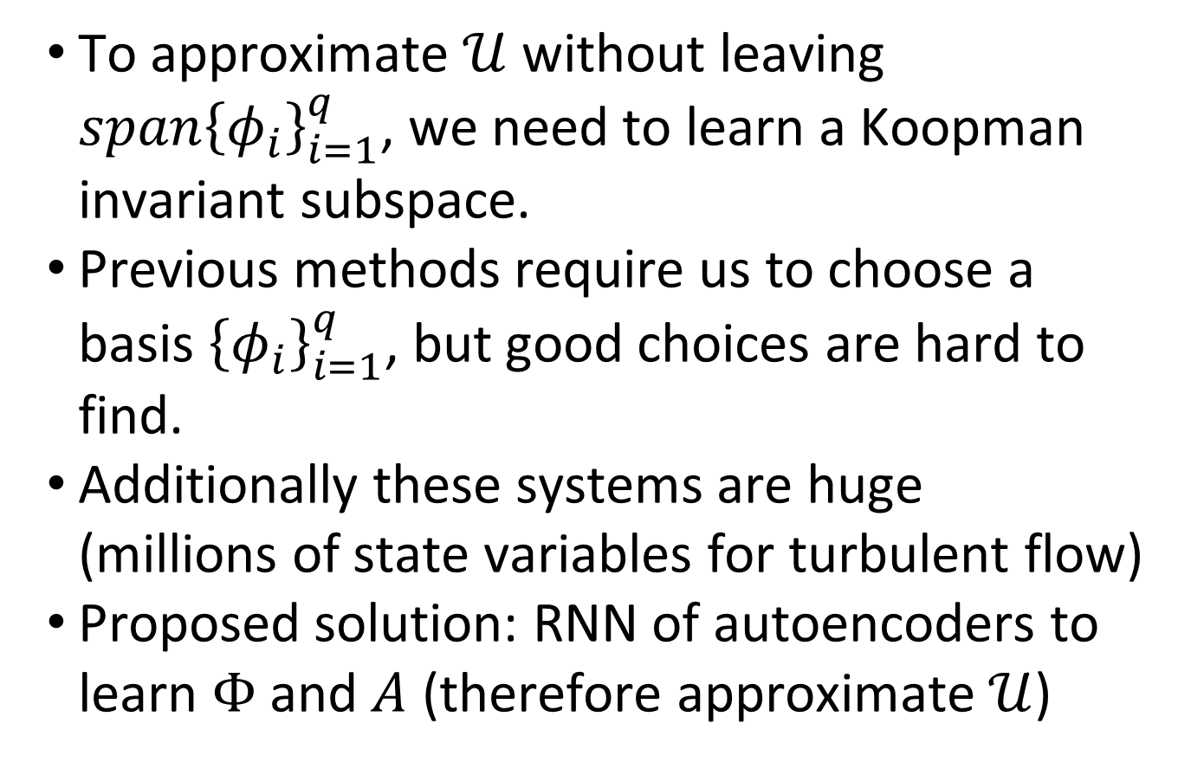
The Koopman Operator
To approximate $𝒰$ without leaving $span{\left\{φ_{i}\right\}}_{i=1}^{q}$, we need to learn a Koopman invariant subspace.
Previous methods require us to choose a basis ${\left\{φ_{i}\right\}}_{i=1}^{q}$, but good choices are hard to find.
Additionally these systems are huge
(millions of state variables for turbulent flow)
Proposed solution: RNN of autoencoders to learn $Φ$ and $A$ (therefore approximate $𝒰$)

Slide 7
Deep Learning Approach
Want: linear dynamics in an intrinsic feature space comprised of nonlinear observables
Use autoencoder to learn an optimal set of nonlinear observables
Nonlinear encoder and decoder
Constrain dynamics to be linear in the intrinsic feature space
Autoencoder need not be contractive since having linear dynamics is a strong constraint.

Slide 8
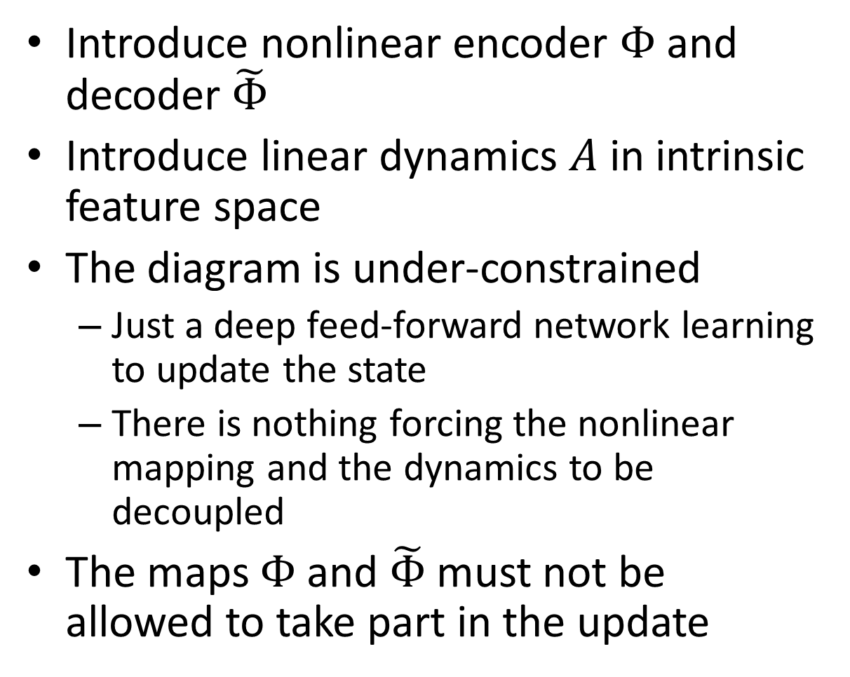







Naïve Approach

Slide 9

















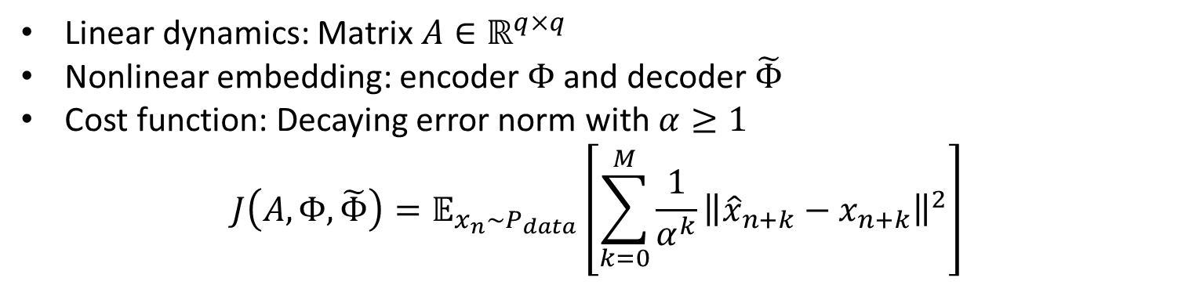
Recurrent Autoencoder Network (I)

Slide 10























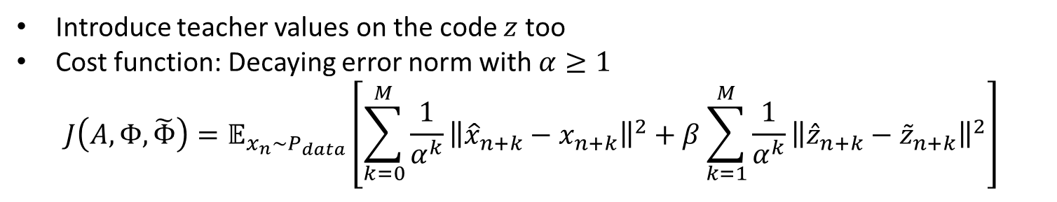
Recurrent Autoencoder Network (II)

Slide 11
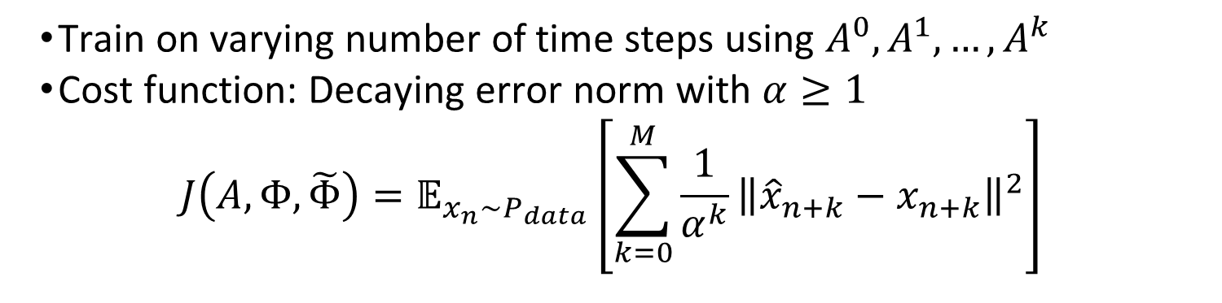

Recurrent Autoencoder Network (III)
$$A^{2}$$
Train on varying number of time steps using $A^{0},A^{1},…,A^{k}$
Cost function: Decaying error norm with $α≥1$
$$J\left(A,Φ,\tilde{Φ}\right)=𝔼_{x_{n}\sim P_{data}}\left[\sum_{k=0}^{M}{\frac{1}{α^{k}}{\left\|{\hat{x}}_{n+k}−x_{n+k}\right\|}^{2}}\right]$$

Slide 12
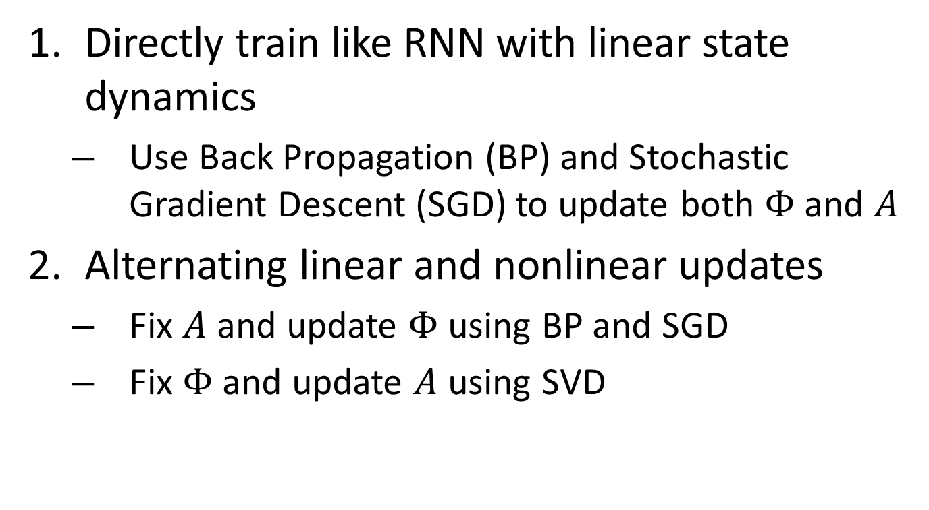
Training Methodology

Slide 13
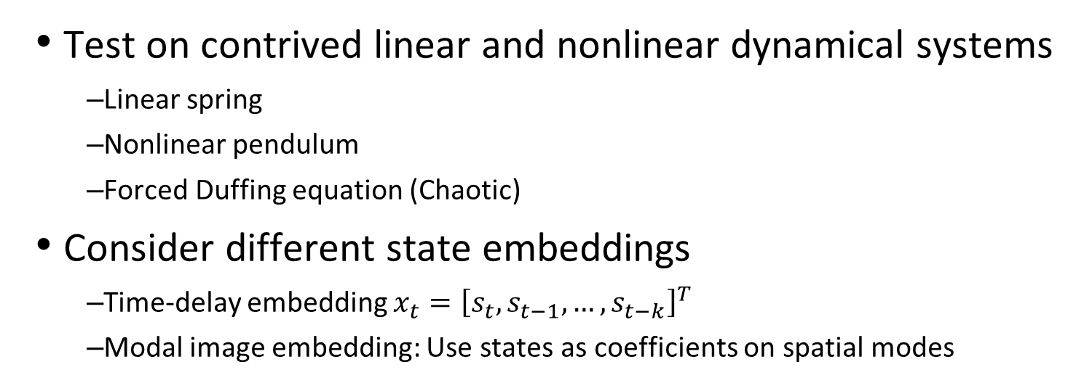
Proposed Test Cases
Test on contrived linear and nonlinear dynamical systems
Linear spring
Nonlinear pendulum
Forced Duffing equation (Chaotic)
Consider different state embeddings
Time-delay embedding $x_{t}={\left[s_{t},s_{t−1},…,s_{t−k}\right]}^{T}$
Modal image embedding: Use states as coefficients on spatial modes

Slide 14
Proposed Test Cases
Results using recurrent autoencoder network will be compared to
Dynamic Mode Decomposition (DMD)
Extended Dynamic Mode Decomposition (EDMD)
Kernel Dynamic Mode Decomposition (KDMD)
Use modal decomposition in intrinsic space to extract dynamically important structures and their time evolution
Koopman spectral analysis ➔ Koopman modes, eigenvalues
Eigenvalues give frequency and damping of modes

Slide 15
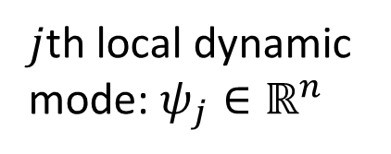

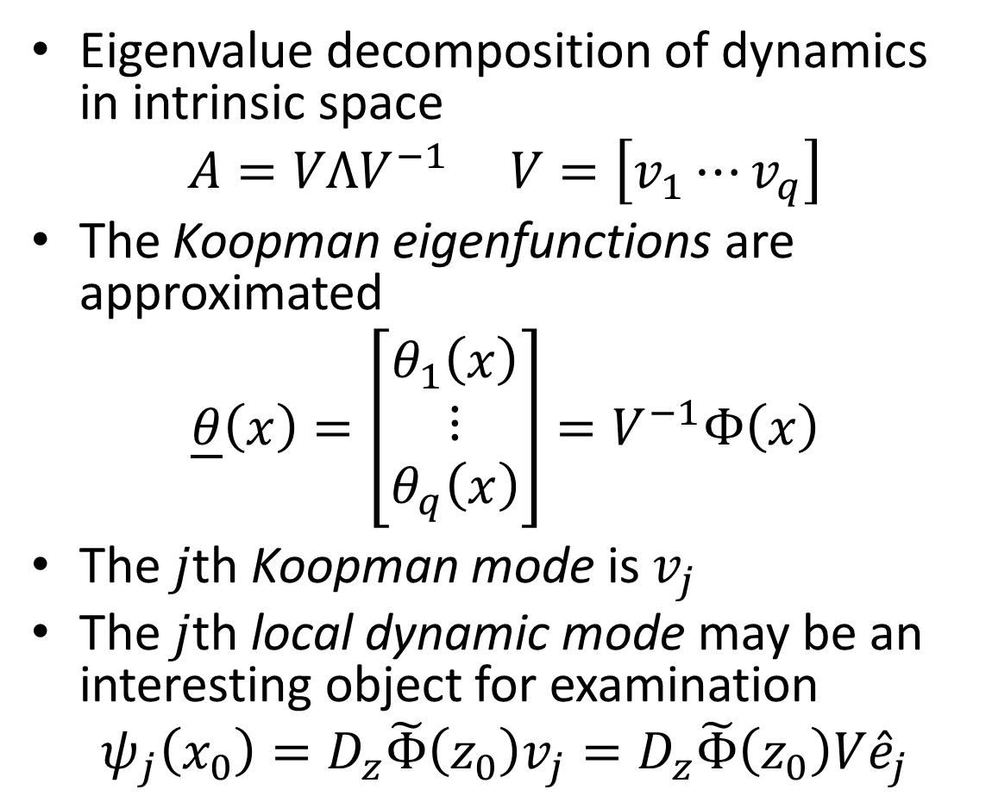


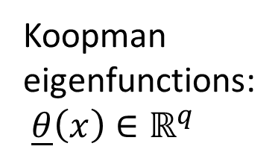



Koopman Spectral Analysis

Slide 16
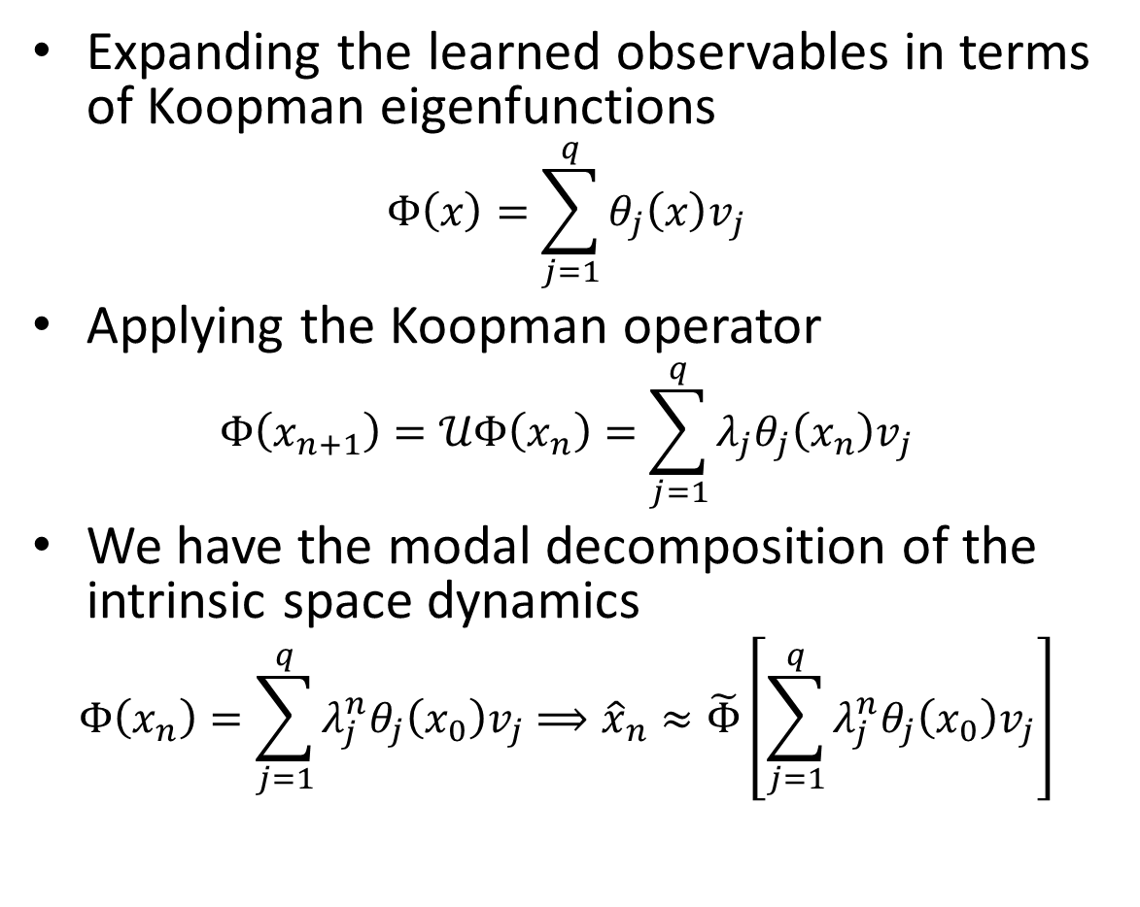
Koopman Spectral Analysis

Slide 17
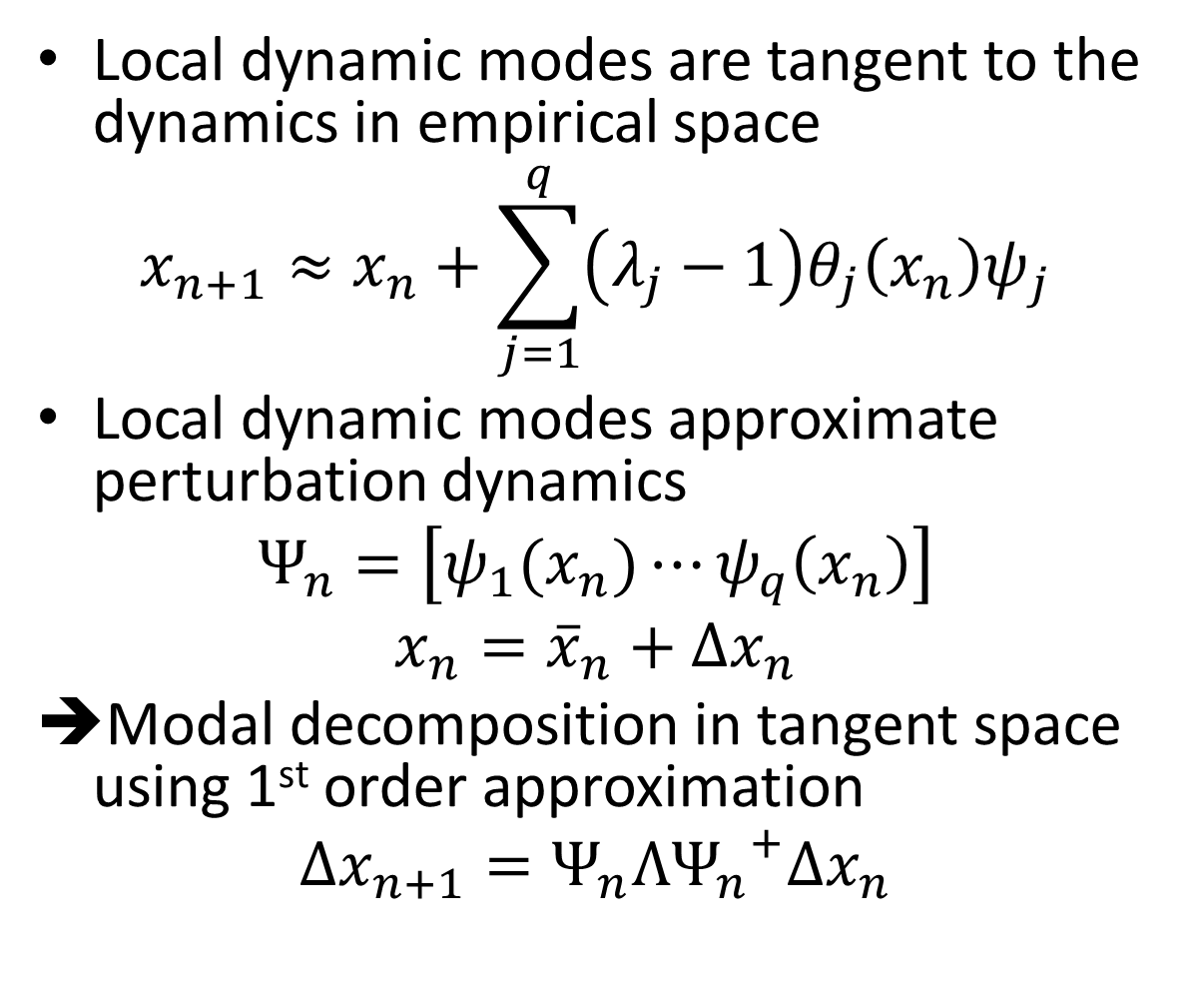








Koopman Spectral Analysis

Slide 18
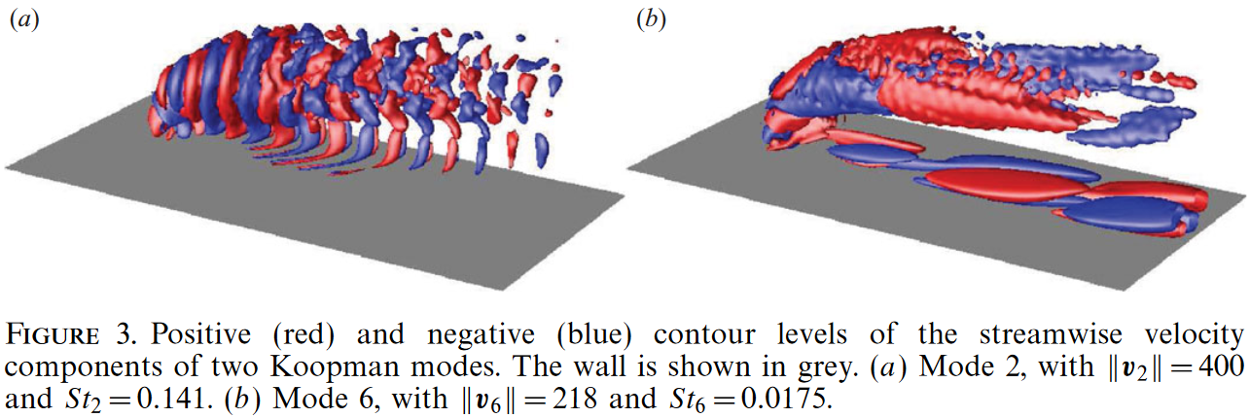
Identification of Dynamically Important Structures
C. W. Rowley, I. Mezic, S. Bagheri, P. Schlatter, D. S. Henningson “Spectral Analysis of Nonlinear Flows”, 2009, J. Fluid Mech
Identification of Koopman modes for fluid jet in crossflow
Linear observables were used
Koopman modes extract dynamically important flow structures and their corresponding time evolution

